Slide 1
Findings presentation
Mateusz Otmianowski

Slide 2
Introduction
This document presents findings gathered through the analysis of dataset from a Pearson e-learning platform;
The major topics that were researched include:
Number of students that are active in a given unit with analysis of changes from unit to unit;
Average scores and completion rates between units;
Comparison of courses with and without a teacher;
Analysis of differences between countries;
Recommendations are presented at the end of this document;

Slide 3
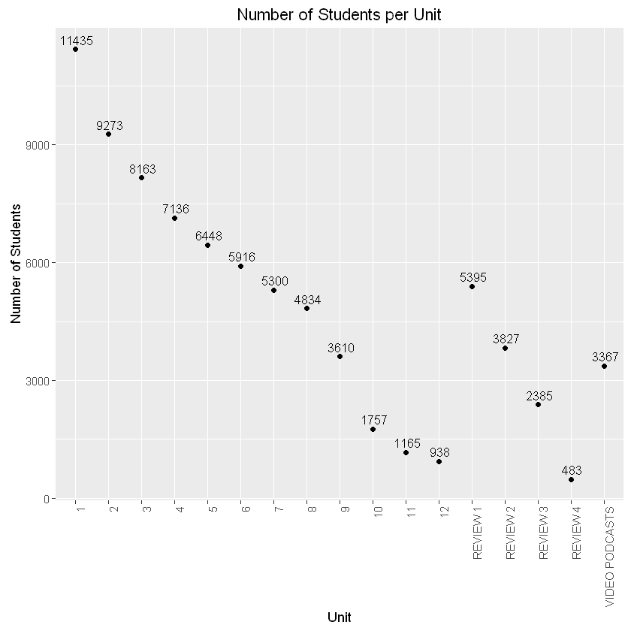
The number of students that perform activities in the given unit is constantly dropping from unit to unit so that from the beginning 11,4 k of students, that are active in the first unit, the final twelfth unit is reached by slightly less than 1 k of students.

Slide 4
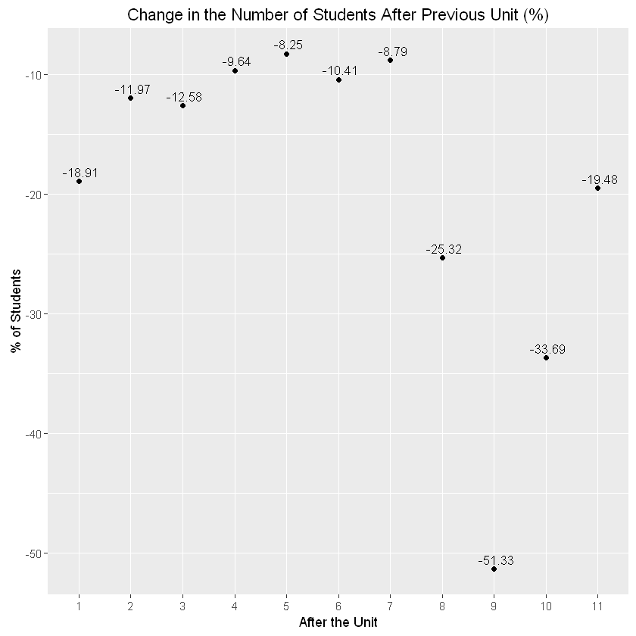
The most significant drops in number of active students happen after the first chapter (might be caused by the fact that students find this form of learning unattractive) and after units 8-11. The number of students that are becoming inactive after the unit 9 is especially staggering as it reaches 51%. The students may find these chapters too difficult or uninteresting. It may also be the case that it is hard for students to maintain the motivation for learning until the end of the course.

Slide 5
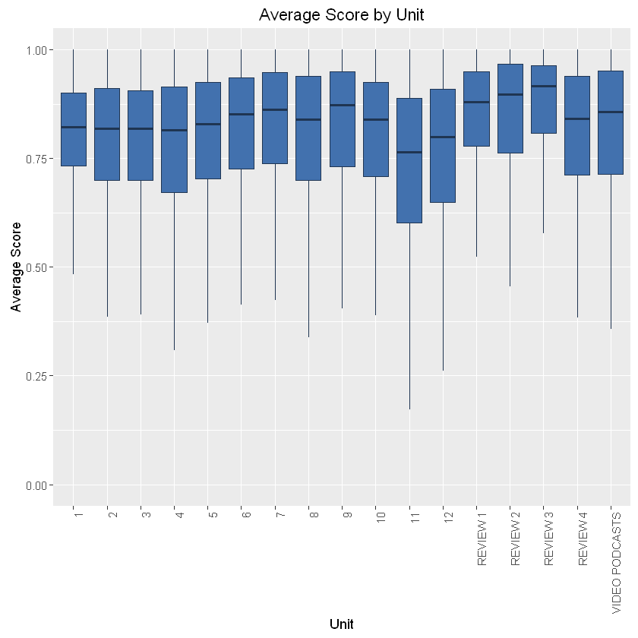
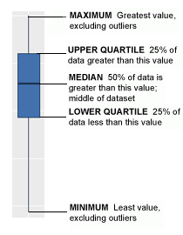
Units 11-12 seems to be slightly harder than the other units as indicated by the lower median scores and the whole distribution of scores for these units on the lower level.
Boxplot explanation:

Slide 6
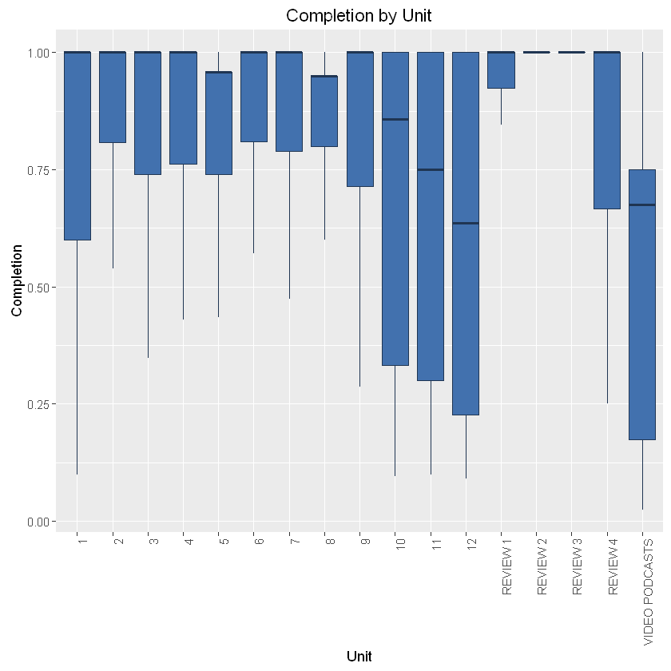
The median completion rates for units 10-12 are significantly lower than for other units. That may indicate that these units are less interesting or comprehensible than other units.
What draws attention is the fact that, although the overall completion rates for units 5 and 8 are only slightly lower than for other chapters, very few students complete them in full.
Reviews have generally high completion rates so they seems to be valued by students.

Slide 7
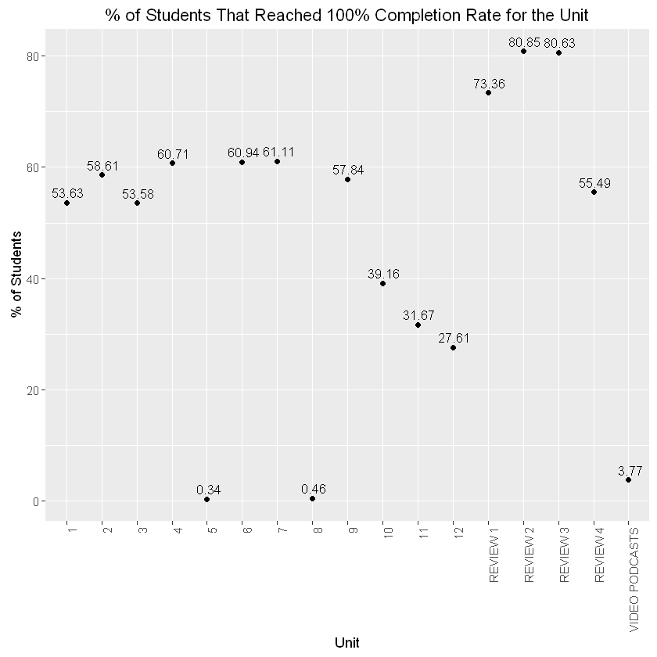
By analyzing percent of students that have reached 100% completion rate for the given unit one can conclude that:
Completion rates for units 10-12 are considerably lower than for other units;
Video podcast may not be very attractive as it is completed in 100% by less than 4% of students;
There are probably one or two very hard, incomprehensible or faulty exercises in the chapter 5 and 8 that almost no one finishes, so the % of students that complete these units is very low;

Slide 8
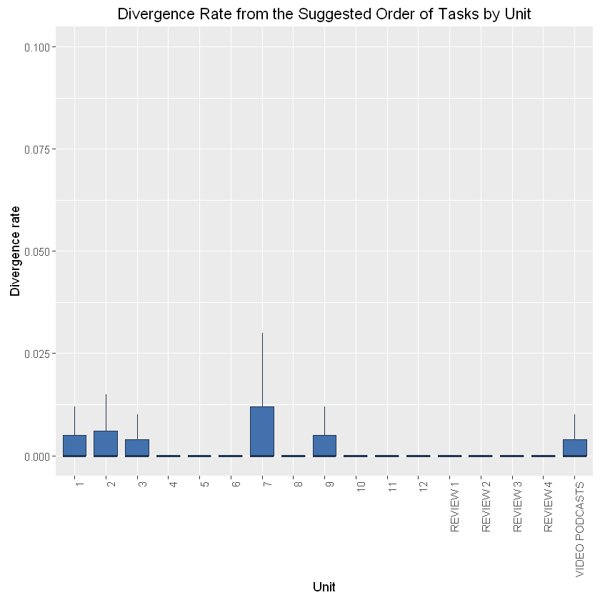
Students seems to be diverging only slightly from the suggested order of tasks with the median divergence for each unit around 0 so this seems not to be a significant issue. The biggest divergence were observed in the unit 7.

Slide 9
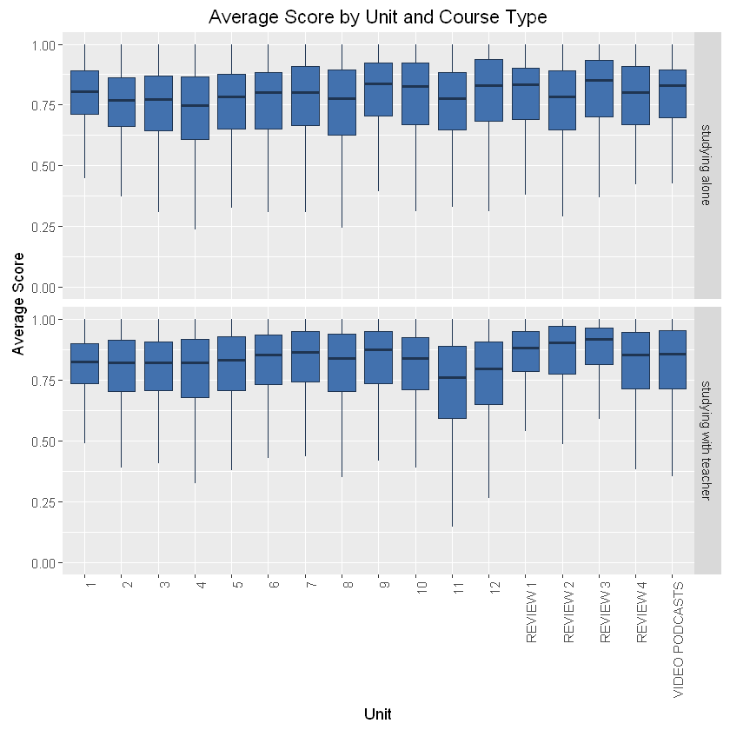
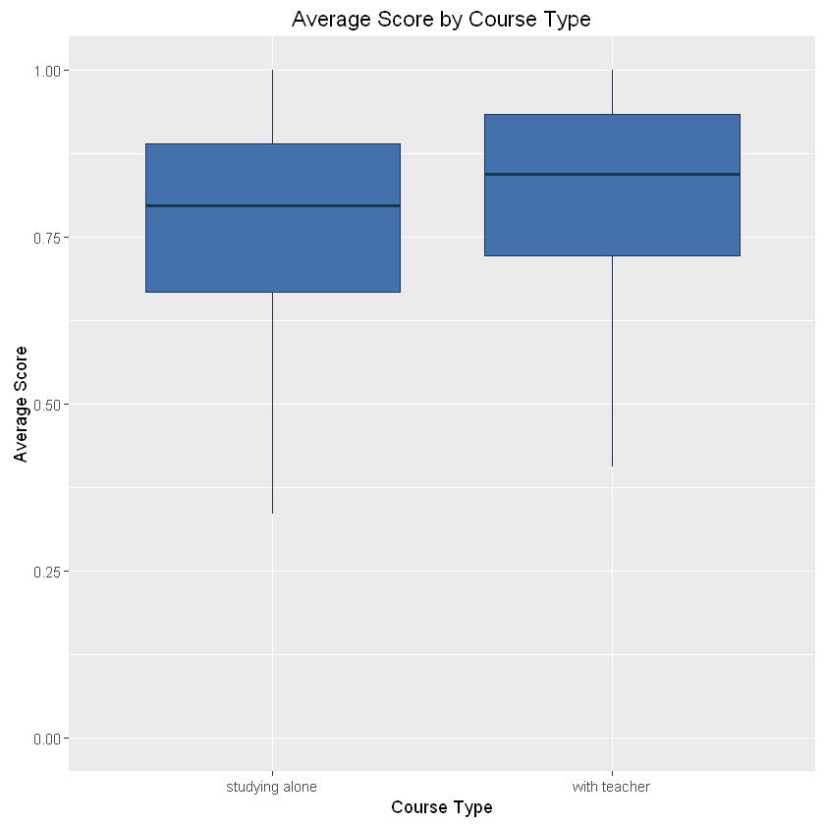
An impact of a teacher on the student scores in a given unit is not very big but noticable. For the whole course median average score for studying with a teacher is 0.84 vs 0.8 for self-studying students.

Slide 10
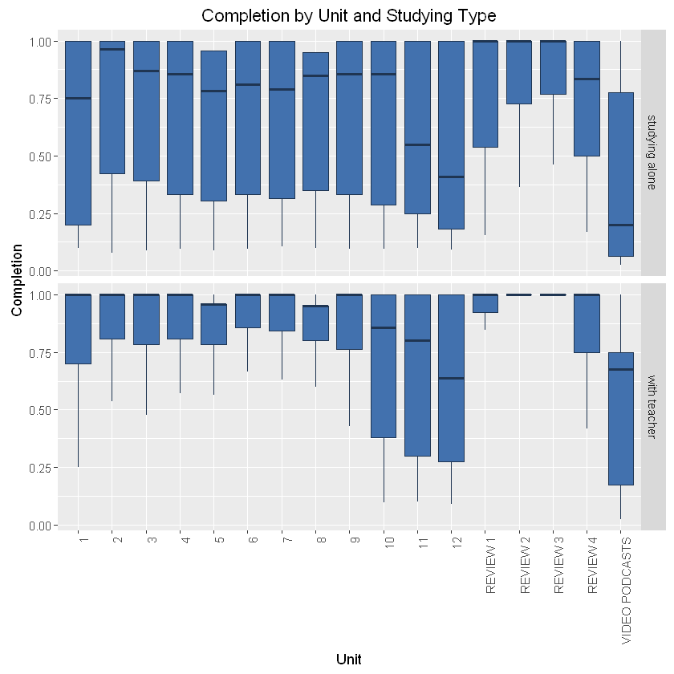
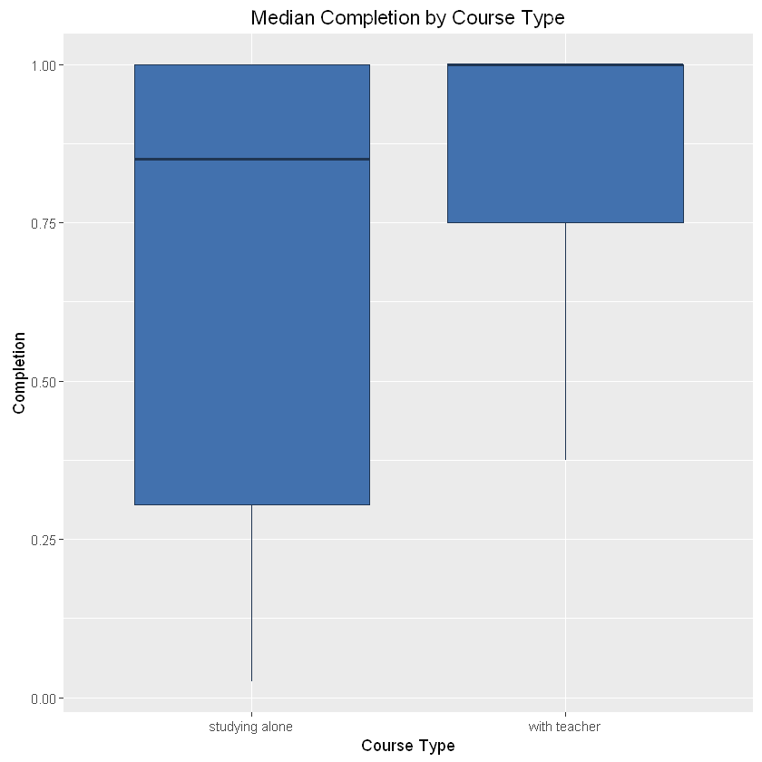
The presence of a teacher is more visible in completion rates, as a courses with a teacher have significantly higher completion rates (median completion rate for a course with a teacher is 100% vs 85% for self-studying students). There are at least two possible explanations:
a teacher provides explanation to the exercises, but as noted on the previous slide this impact is not very big;
she/he is able to motivate students;
Taking the above mentioned into consideration, in order to help self-studying students, it would be recommended to introduce a clearer description of exercises and more engaging tasks with better gratification (ex. ranks);
Additionally video podcasts seems to be a good companion to the teacher led classes but are not very popular in the self studying group.

Slide 11

There are considerable differences in completion rates and average score between countries. It maybe worthwhile to investigate countries with below average completion rates and below average scores (ex. Libya, Yemen, Kuwait and Hong Kong) because materials could be difficult for students in these countries to understand and/or there may be some cultural factors that come into play.

Slide 12
Recommendations
Ways of engaging the students throughout the whole course should be devised to amend the problem of constant drop in students numbers from unit to unit;
Payments plans should be reviewed to take advantage from drop out patterns (incentives to pay for the whole course at the beginning should be introduced because of an early enthusiasm);
Units 5, 8, and 10-12 should be reviewed for the difficulty and attractiveness;
Materials could be tweaked for the lowest performing countries;

